Slide 1
GOPEDAL

Slide 2
TEAM MEMBER
SAYED MEHEDI AZIM 011162097
MD. FANIR-AL-MAMUN 011161142
ANIKA TABASSUM 011161150
ASHRAFUNNESA 011162040
KAZI RAYED HOSSAIN 011162030
SHARFARAZ MAHMOOD JAMEE 011161183

Slide 3

HOME

Slide 4


Slide 5
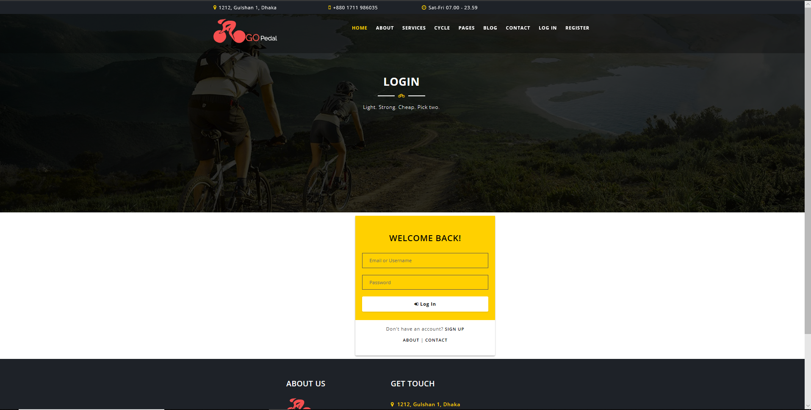
LOGIN

Slide 6

REGISTER

Slide 7
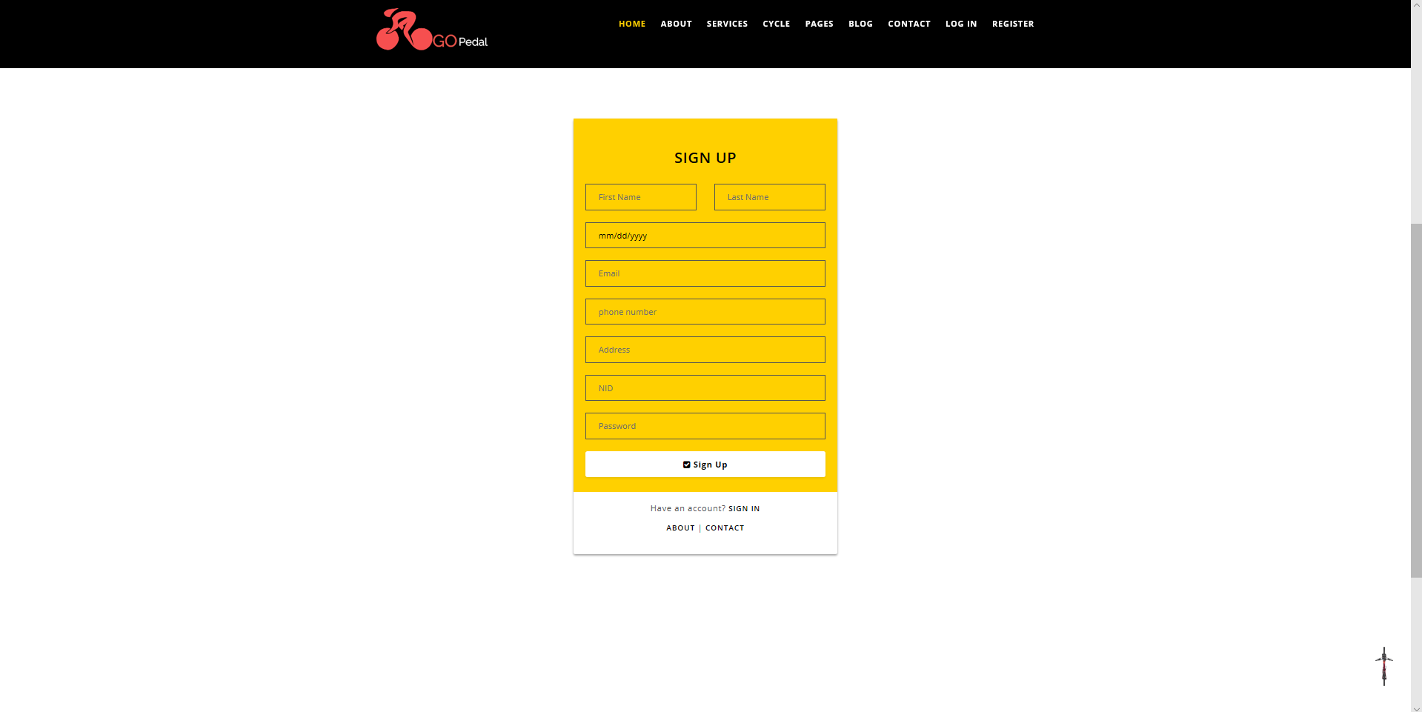

Slide 8

SERVICES

Slide 9
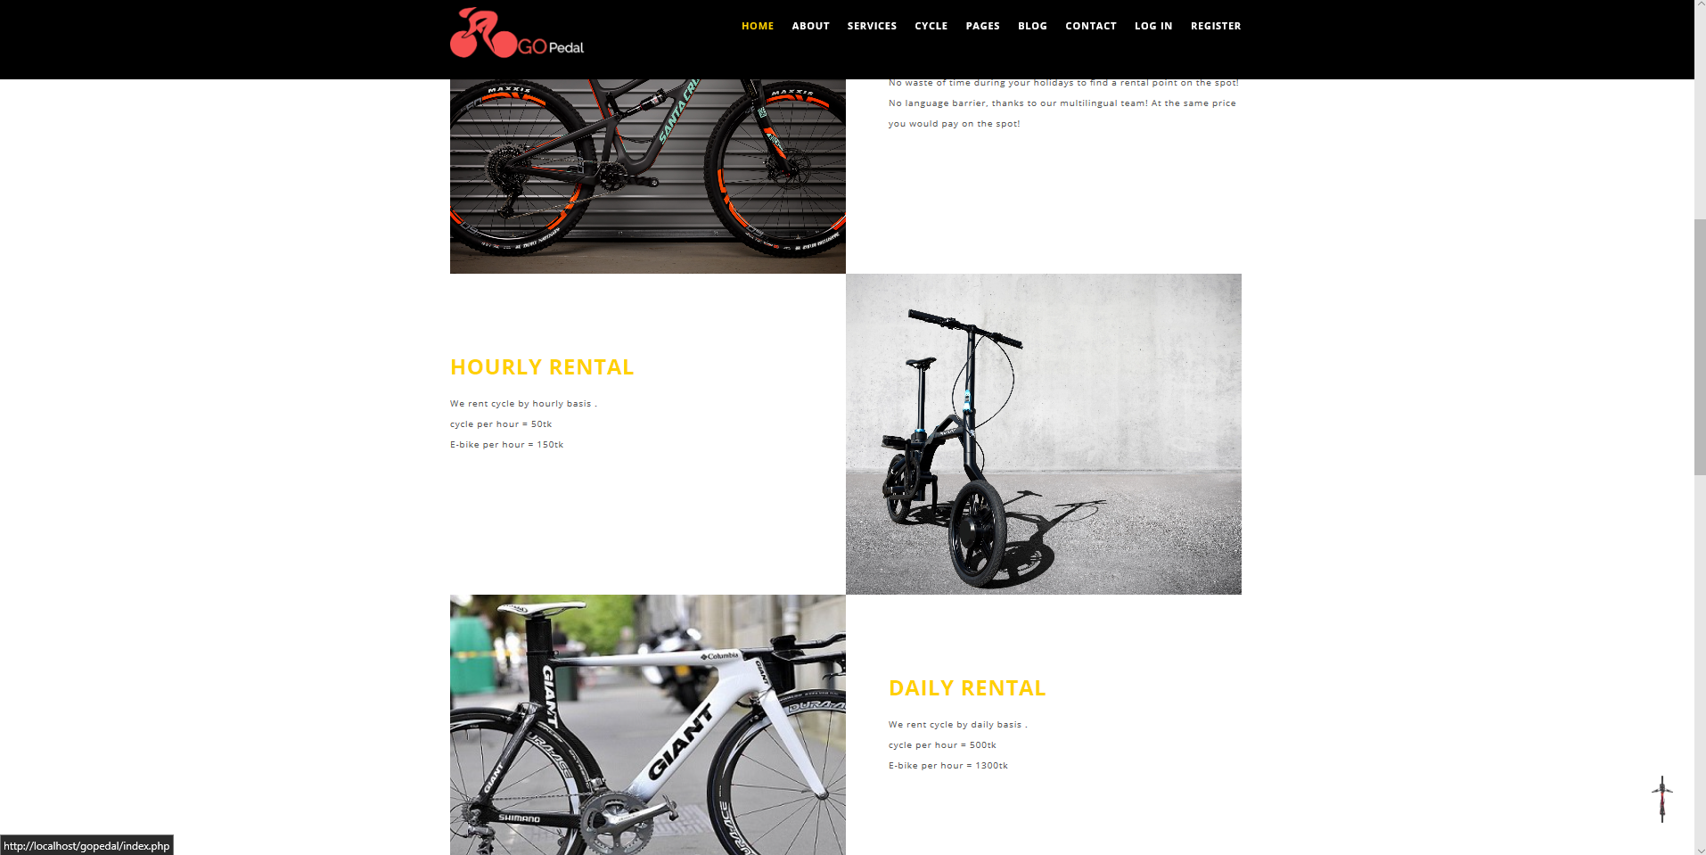

Slide 10
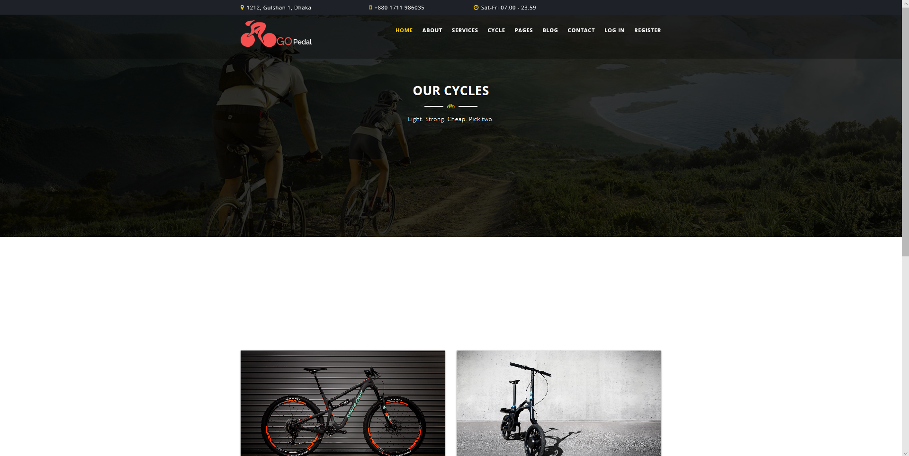
CYCLES

Slide 11


Slide 12


Slide 13
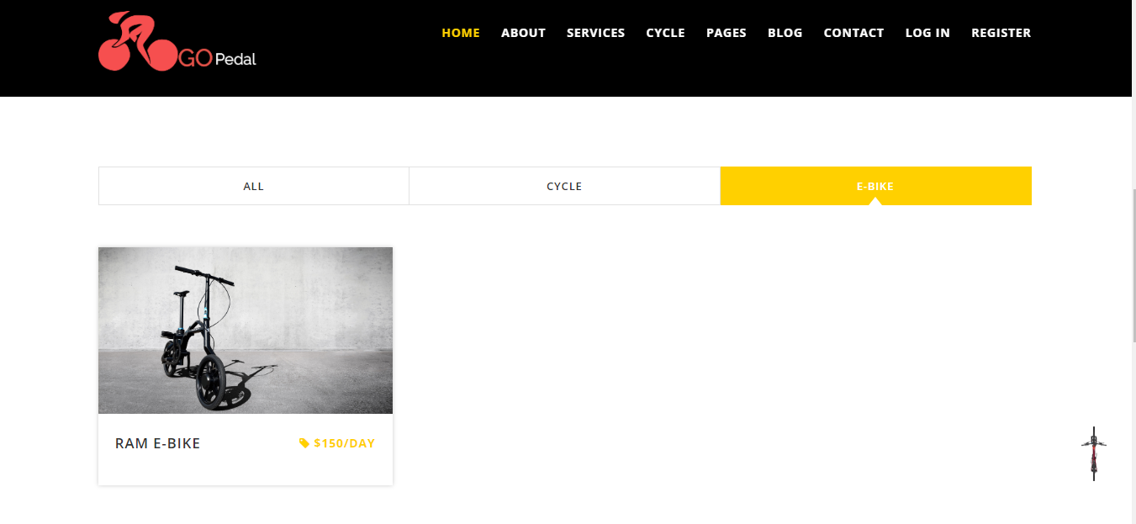
CYCLE

Slide 14

BOOKING

Slide 15

BOOKING

Slide 16

BOOKING

Slide 17

BOOKING

Slide 18
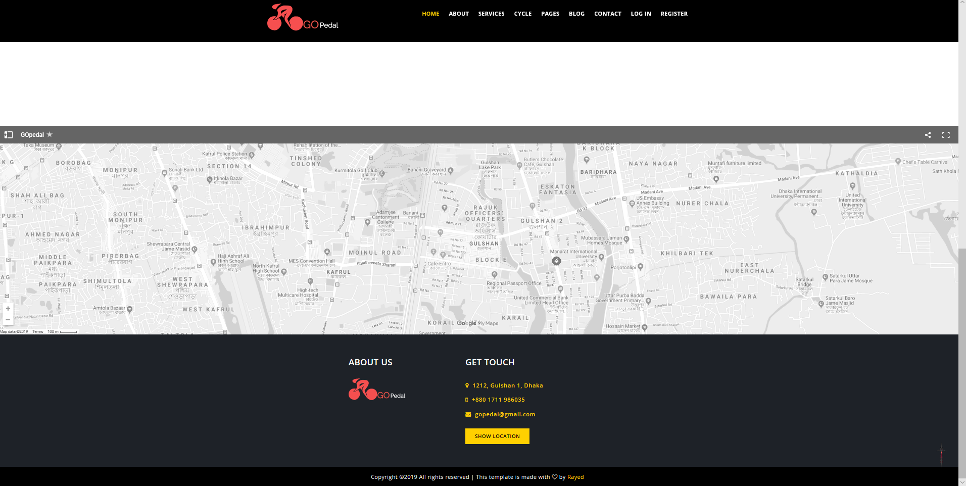

Slide 19
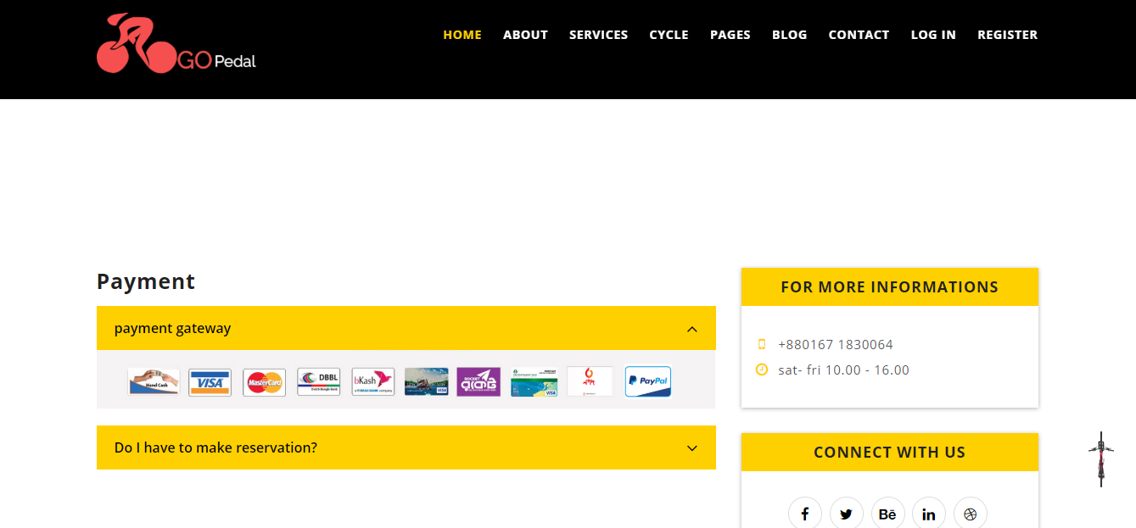
PAYMENT

Slide 20
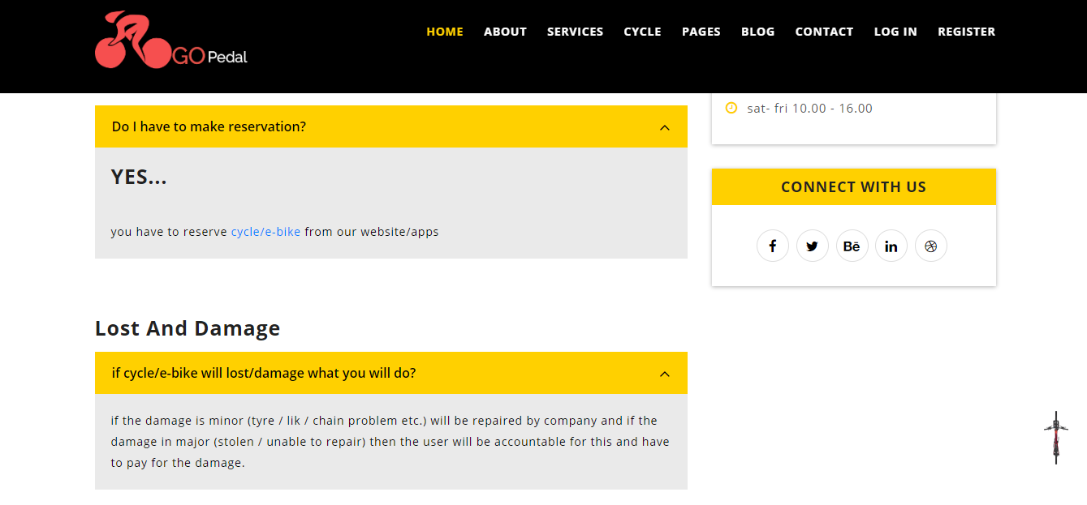
FAQs

Slide 21

REVIEW

Slide 22
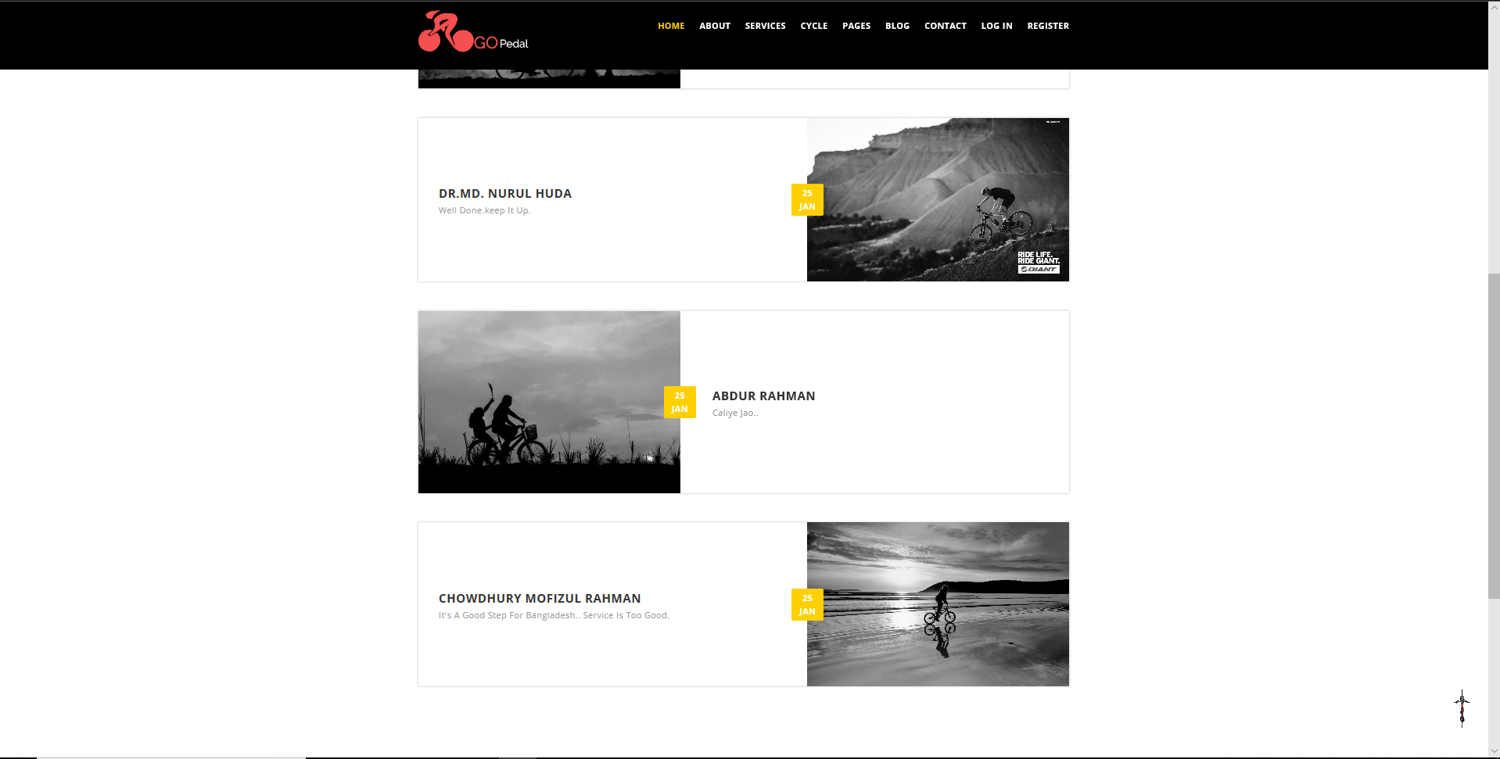

Slide 23

ABOUT

Slide 24
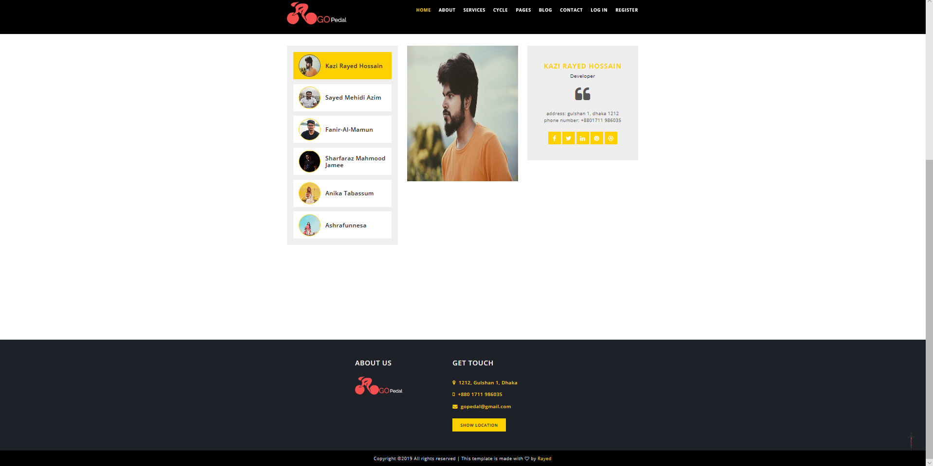

Slide 25


Slide 26
THANK YOU

